Slide 2
… but now they have seen and also hated both Me and My Father. But this happened that the word might be fulfilled which is written in their law, they hated Me without a cause. (Jn 15:24-25)
But they (the people) were insistent, demanding with loud voices that He be crucified. And the voices of these men and of the chief priests prevailed. So Pilate gave sentence that it should be as they (the people) requested. And he released to them the one they requested, who for rebellion and murder had been thrown into prison; but he delivered Jesus to their will (of the people).
(Lk 23:23-25)
Men of Israel, hear these words: Jesus of Nazareth, a Man attested by God to you by miracles, wonders, and signs which God did through Him in your midst, as you yourselves also know—Him, being delivered by the determined purpose and foreknowledge of God, you have taken by lawless hands, have crucified, and put to death …
(Acts 2:22-23)

Slide 3
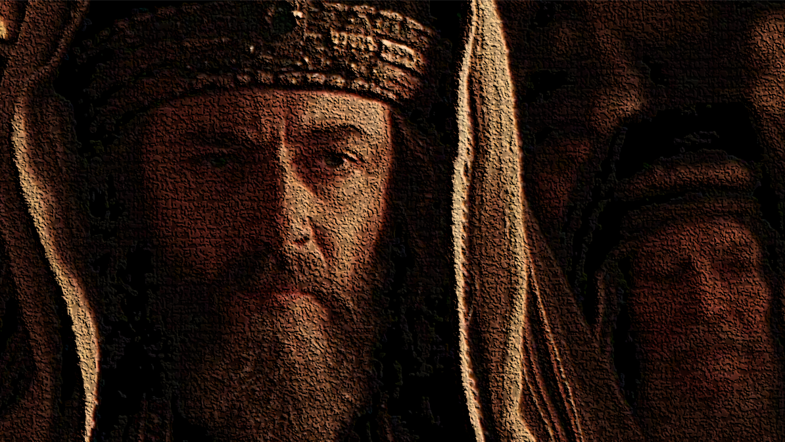
… God anointed Jesus of Nazareth with the Holy Spirit and with power, who went about doing good and healing all who were oppressed by the devil, for God was with Him.
Acts 10:38
Jesus healed the Sick ~ Lk 4:40
He cast out demons ~ Lk 4:41
He raised the Dead ~ Lk 7:14
He fed the Hungry ~ Jn 6:1-14
He comforted the Grieving ~ Jn 11:23
He revealed the Father ~ Jn 14:7-11
He provides access to God ~ Jn 14:6

Slide 5
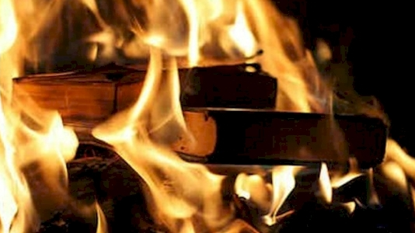
And you will be hated by all for My name’s sake. But he who endures to the end will be saved. (Matt 10:22)
Then they will deliver you up to tribulation and kill you, and you will be hated by all nations for My name’s sake. (Matt 24:9)
Blessed are you when they revile and persecute you and say all kinds of evil against you falsely for My sake. (Matt 5:11)
Do not marvel, my brethren, if the world hates you. (1 Jn 3:13)

Slide 6
Christians believe in Divine Creation, Gen 1:1; Mk 13:19
Christians believe God created two sexes, Gen 1:27; Mt 19:4
Christians believe one’s race is unimportant, Gen 1:27; Jas 3:9
Christians believe God controls the environment, Gen 8:22; Col 1:17
Christians believe in Truth in an age of relativism, Jn 8:32; Jn 17:17; Eph 4:15

