Slide 1
“A Malignant Disease”
“an evil affliction” KJ2000
“an evil disease” KJV
“a severe affliction” NASB
“a grievous affliction” ISV
Eccl.5:10-6:2

Slide 2
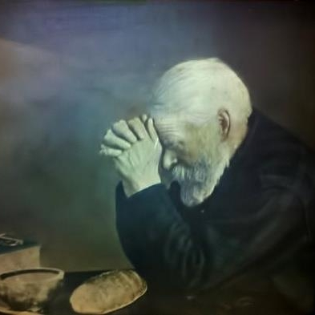
“A Malignant Disease”
A Bad Attitude About Money
5:10, Love of Money
5:11, Only Use One at a Time
5:12, No Sleep
5:13, Keep To One’s Own Hurt
5:14, Calamity Can Take it all Away
5:15-17, Can’t Take it With You
5:18-20, The Right Attitude to Have
6:1-2, A Common Problem

Slide 3
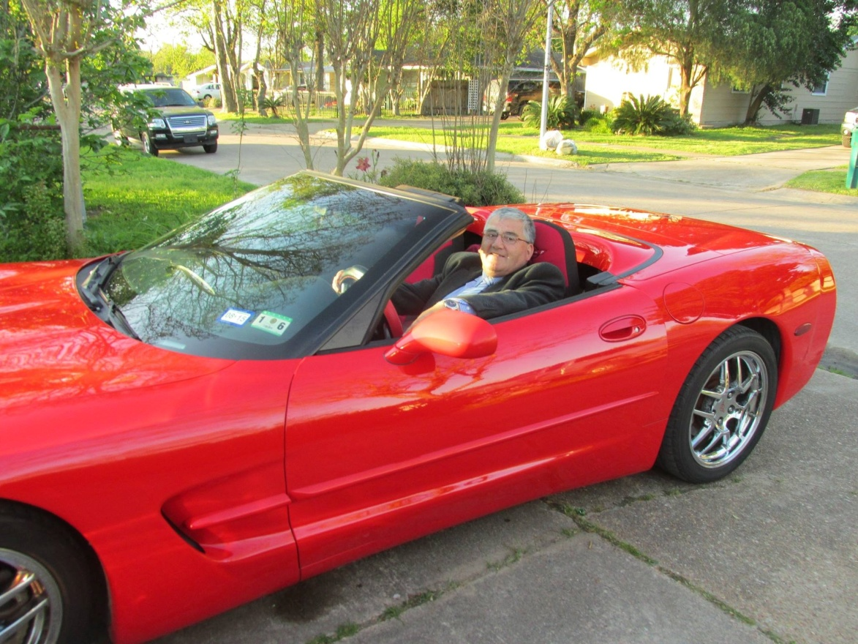
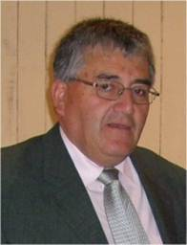
“A Malignant Disease”
Envy and Jealously
Uneasy, uncomfortable, displeasure of the good of another
Prov.14:30
Matt.27:18
Gen.37:4, 5, 11, 33
Illustration

Slide 4
“A Malignant Disease”
The Spirit of Liberalism
Loose, Lax, Not Constricted or Confined to the Law of God
Lev.10:1-2
2 Chron.26:16-21
2 Thess.2:3-7

Slide 5
“A Malignant Disease”
Root of Bitterness
Sharp disagreeable taste. Soured on Life
Heb.12:15
Acts 8:23
Prov.18:19
Jesus is the Great Physician
The Gospel is the Cure

Slide 6
The Plan of Salvation
Hear the Gospel of Christ, Rom.10:17
Believe in Jesus Christ, Rom.5:1
Repent and Turn to God, Luke 24:47
Confess Jesus Before Men, Acts 8:37
Be Baptized for the Remission of Sins, Ac.2:38
---------------------------------
Grow in the Lord, 2 Pet.3:18
If Err From The Faith: Repent and Pray God, Acts 19:18

